Slide 1
EURAF in Spain
Spanish Agroforestry Association
Agroforestry in the new CAP
(Elegibility of trees in Spain)

Slide 2
Spanish Agroforestry Association
AGFE: Asociación Agroforestal Española
Recently created
38 members, included some companies and foundations
Individuals include researchers and other stakeholders
We expect more members once AGFE has been created
We have bring the money for EURAF.

Slide 3
Agroforestry in the CAP in Spain
No news, only some whispers
A very opaque process (more than ever before) for both Pilar I and Pilar II.
We expect measure 23 will be adopted in some regions.
We have a strong discussion for the elegibility of silvopastures and silvoarables and the criteria to define a coefficient of admisibility.

Slide 4
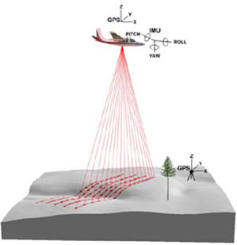
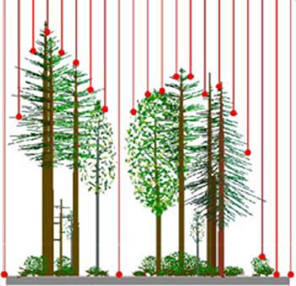
Elegibility in Spain
Admisibility Coefficient (%) = Soil Factor (vegetated)* Slope Factor * Type of Vegetation
LIDAR
(Density and Height
of Trees and Shrubs)

Slide 5
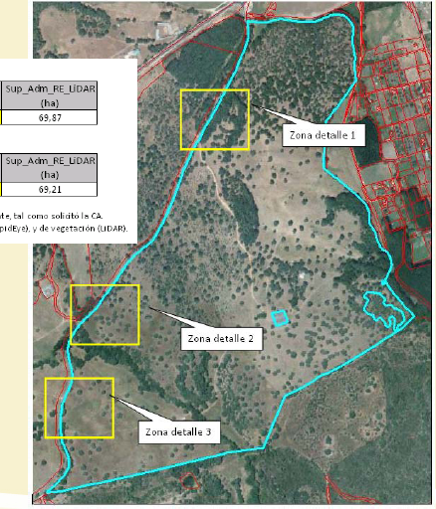
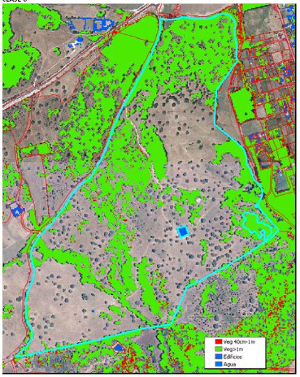
Elegibility in Spain
Admisibility Coefficient (%) = Soil Factor (vegetated)* Slope Factor * Type of Vegetation

Slide 6
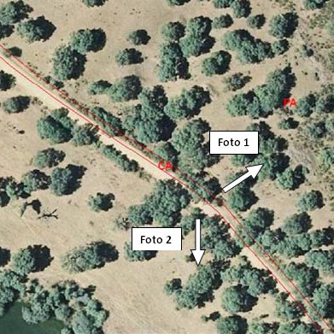
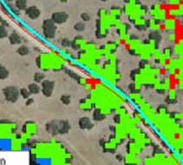
Elegibility in Spain
% Elegibility = Soil Factor (vegetated)* Slope Factor * Type of Vegetation

Slide 7
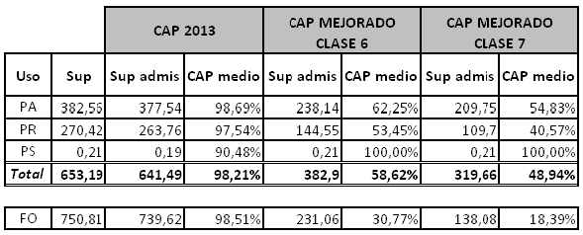
Elegibility in Spain
% Elegibility = Soil Factor (vegetated)* Slope Factor * Type of Vegetation

