Slide 1
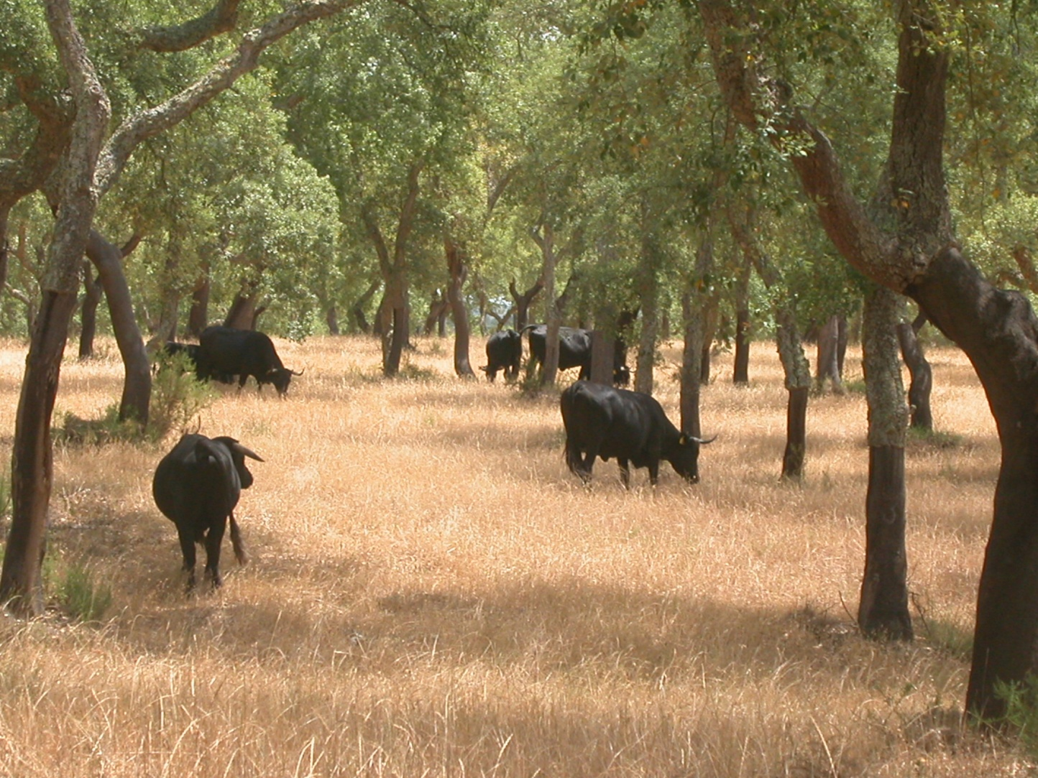
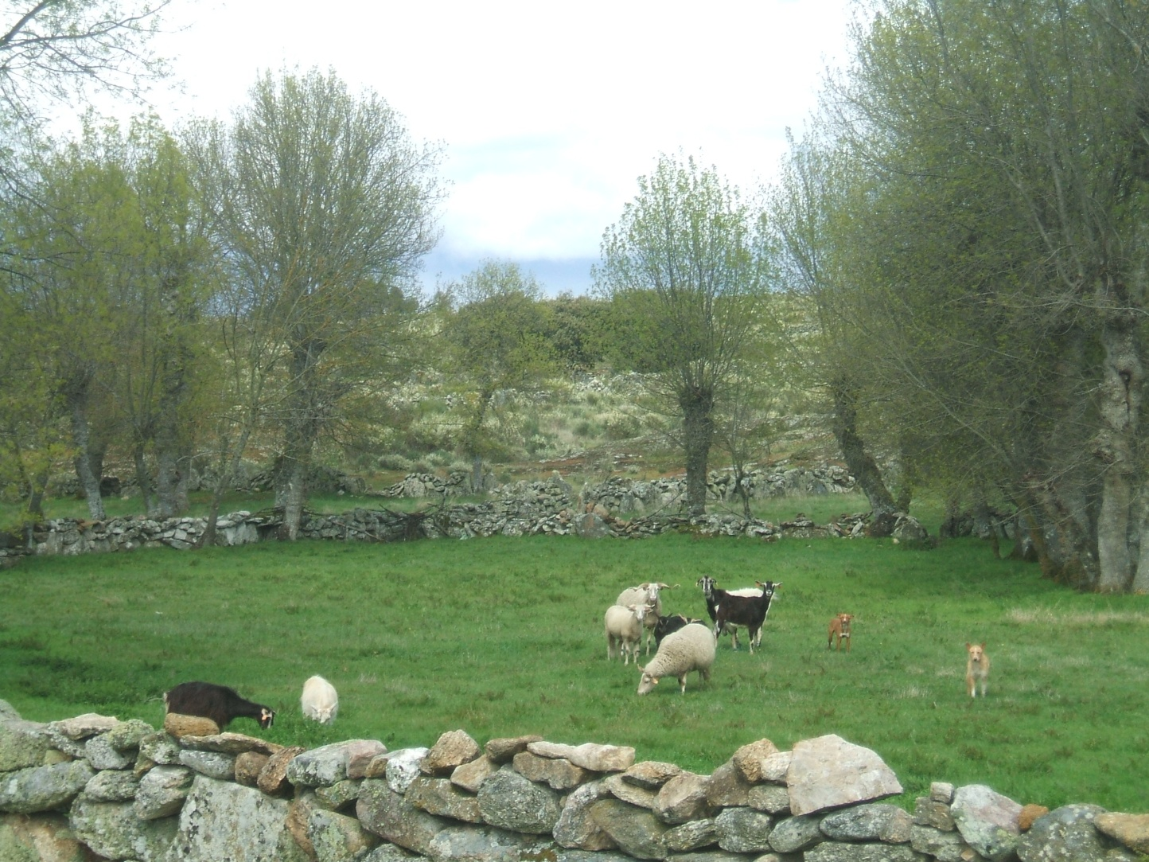
Joana A Paulo, João HN Palma
Cottbus, June 2014

Slide 2
General overview:
Agroforestry systems, mainly traditional systems, are well recognized in Portugal
    From a list of 18 priorities included in the preliminary version (March 2014) of the new rural development plan for 2014-2020, 11 can be directly or indirectly benefit from Agroforesty systems
    Along the document ‘Agroforestry systems’ is typed 22 times
The new document presents supporting measures structured in a very similar way to the previous one
Previous constrains, that lead to low adoption by farmers of the support for new agroforests installation ,may be maintained in the 2014-2020 period.

Slide 3
Pros / Forward
    One specific measure for the installation of Agroforestry systems (A8.1 Op2; identical do measure 2.3.2.2)
    Minimum area: 0.5 ha
    Definition of measures for knowledge transfer and dissemination to farmers
      courses, demonstration activities and interchange (national and international) , technical consultation…
      ‘greening and maintenance of agriculture land’ as one of the main subjects (although no explicit reference to agroforests is made…)

Slide 4
Cons / Backward / Uncertainty
Zonal support to maintenance of XXXX (A7.3) still limits maximum tree density to 60 trees/ha with ht > 2,5 m
RPU still incompatible with the installation of Agroforestry systems?
Forest management plan still for compulsory for the support to the installation of new agroforest areas??
Fast growing specie definition: 8 to 20 years rotation
No reference for support of biomass production in agroforestry systems
Maximum financial support for initial investment from each measure still not defined (previously this value was inferior for the measure regarding agroforestry systems installation that for the forestation measure)

Slide 5
Knowledge and awareness of the benefits of new types of agroforesty systems (e.g. alley cropping) is still very limited in Portugal at political, technical and private owners scales
    => traditional country!
A separation of funding measures still exists for agricultural and forest areas, that many times is traduced by a non attractive results for farmers investment
    => Agroforestry is a ‘all man’ / ‘no man’ territory!

Slide 6
Previous constrains regarding the definition of eligibility criterions, that lead to low adoption by farmers of the support for new agroforests installation ,may be maintained in the 2014-2020 period
    => avoid this lost opportunity!
Opportunities for knowledge transfer for different stakeholders must be put to use!
=> learn with others around Europe/World!
=> exchange experiences!
=> EURAF has an essential role in this long journey!

