Slide 1
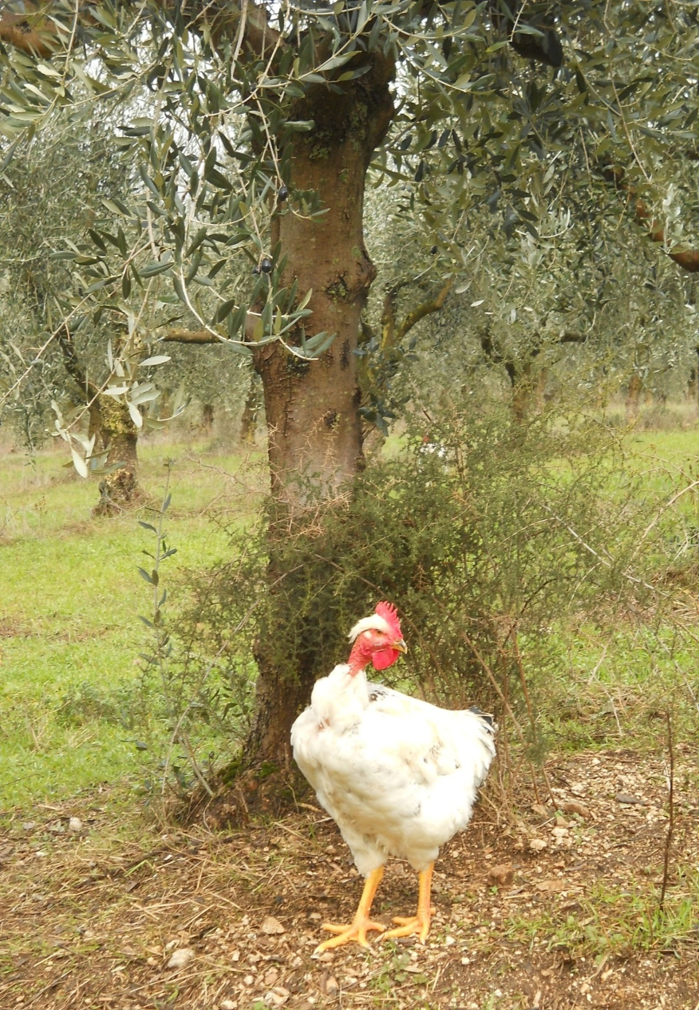
2013 was an active year for Italian Agroforestry
A working group on Agroforestry has been established within the SISEF (Italian Society for Forestry and Forest Ecology).
The group was founded in September 2013, at SISEF’s 9th national congress, where contributions related to agroforestry were among the papers presented.
Through SISEF, all members of the working group on agroforestry became members of EURAF.
We had 10 members in 2013 and are now 13 members in 2014

Slide 2
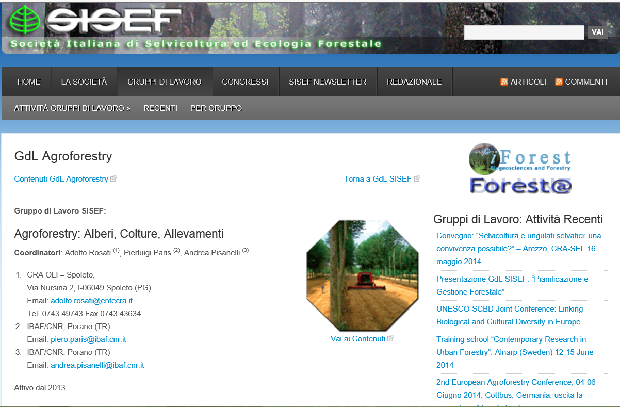

Slide 3
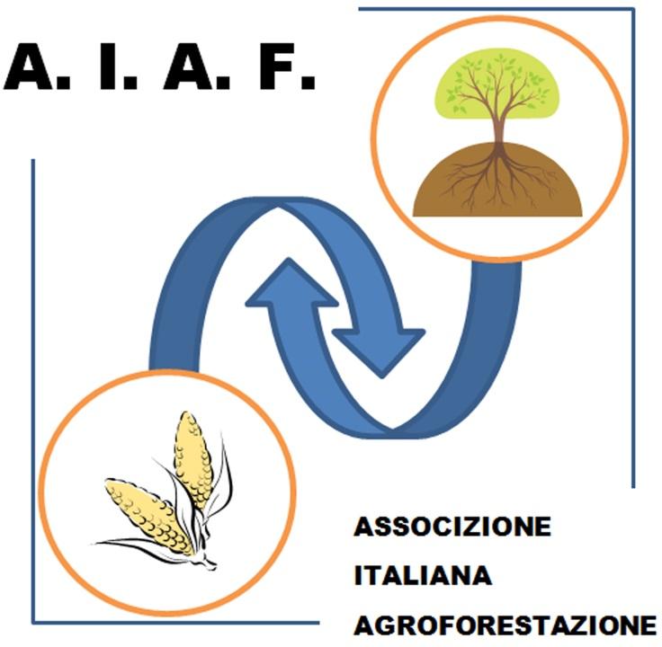
AIAF ASSOCIAZIONE ITALIANA PER L’AGROFORESTAZIONE (Italian Association for Agroforestry)

Slide 4
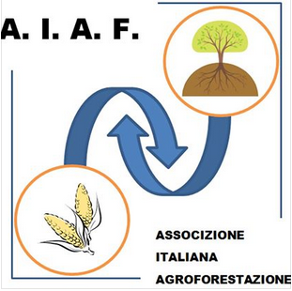
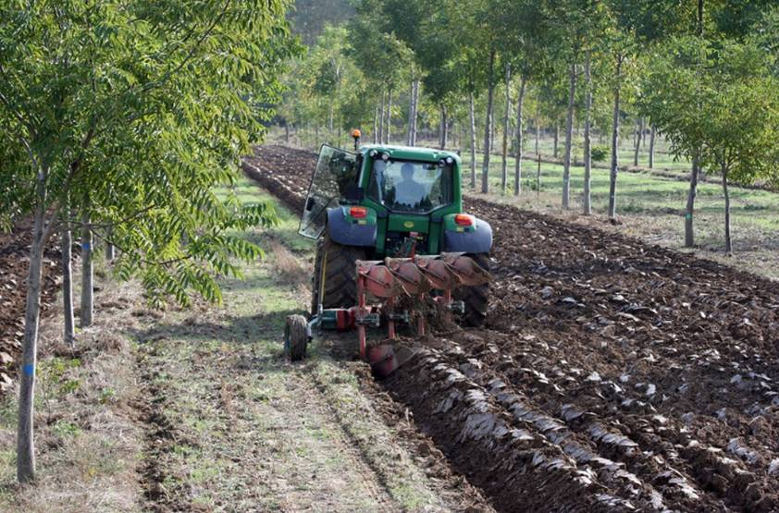
AIAF
Founded in 2014
Private owners, professionals, researchers, farms and public bodies
Supports awareness, knowledge, research policies
Follow the experiences of other countries (AFAF)
Promotes wood certification schemes
Cooperate with other agroforestry associations and others, in particular with EURAF
Promote synergies to improve the final products and the many services of farms
Partnership projects at the European level to promote agroforestry
Promote cultivation and cultural aspects related to the tree in agricultural contexts

Slide 5
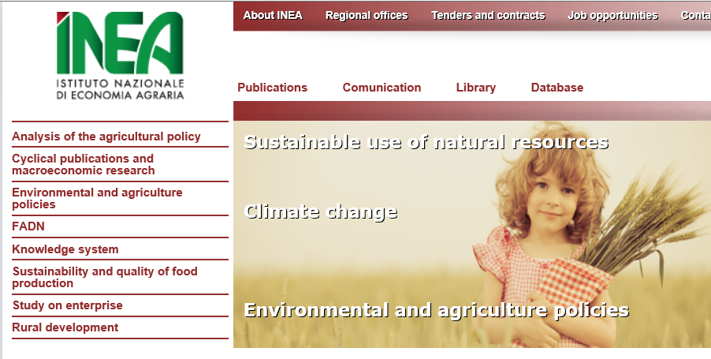
Agroforestry working group lead by INEA
A working group on Agroforestry policy had been activated, under the leadership of INEA (Agrarian Economy National Institute). The group has been working on studying the statistics, successes and failure of measure 222 (agroforestry), and the impact and importance of policy.
Problems with agroforestry policy implementation in Italy
Produce guidelines for the Regions to implement AF policy (RDP)

Slide 6
Italian EURAF Members
SISEF
AIAF
13 members
14 members
27 members

Slide 7
2013 was an active year for Italian Agroforestry
AGFORWARD, the large agroforestry project, funded within the VII FP, involves three Italian partners: CRA, CNR, and Veneto Agricoltura.
CRA: Olive AF with crops and animals
CNR: Arable AF (e.g. wulnut and arable crops)
VA: Grazing AF (e.g. pigs in poplars)

Slide 8
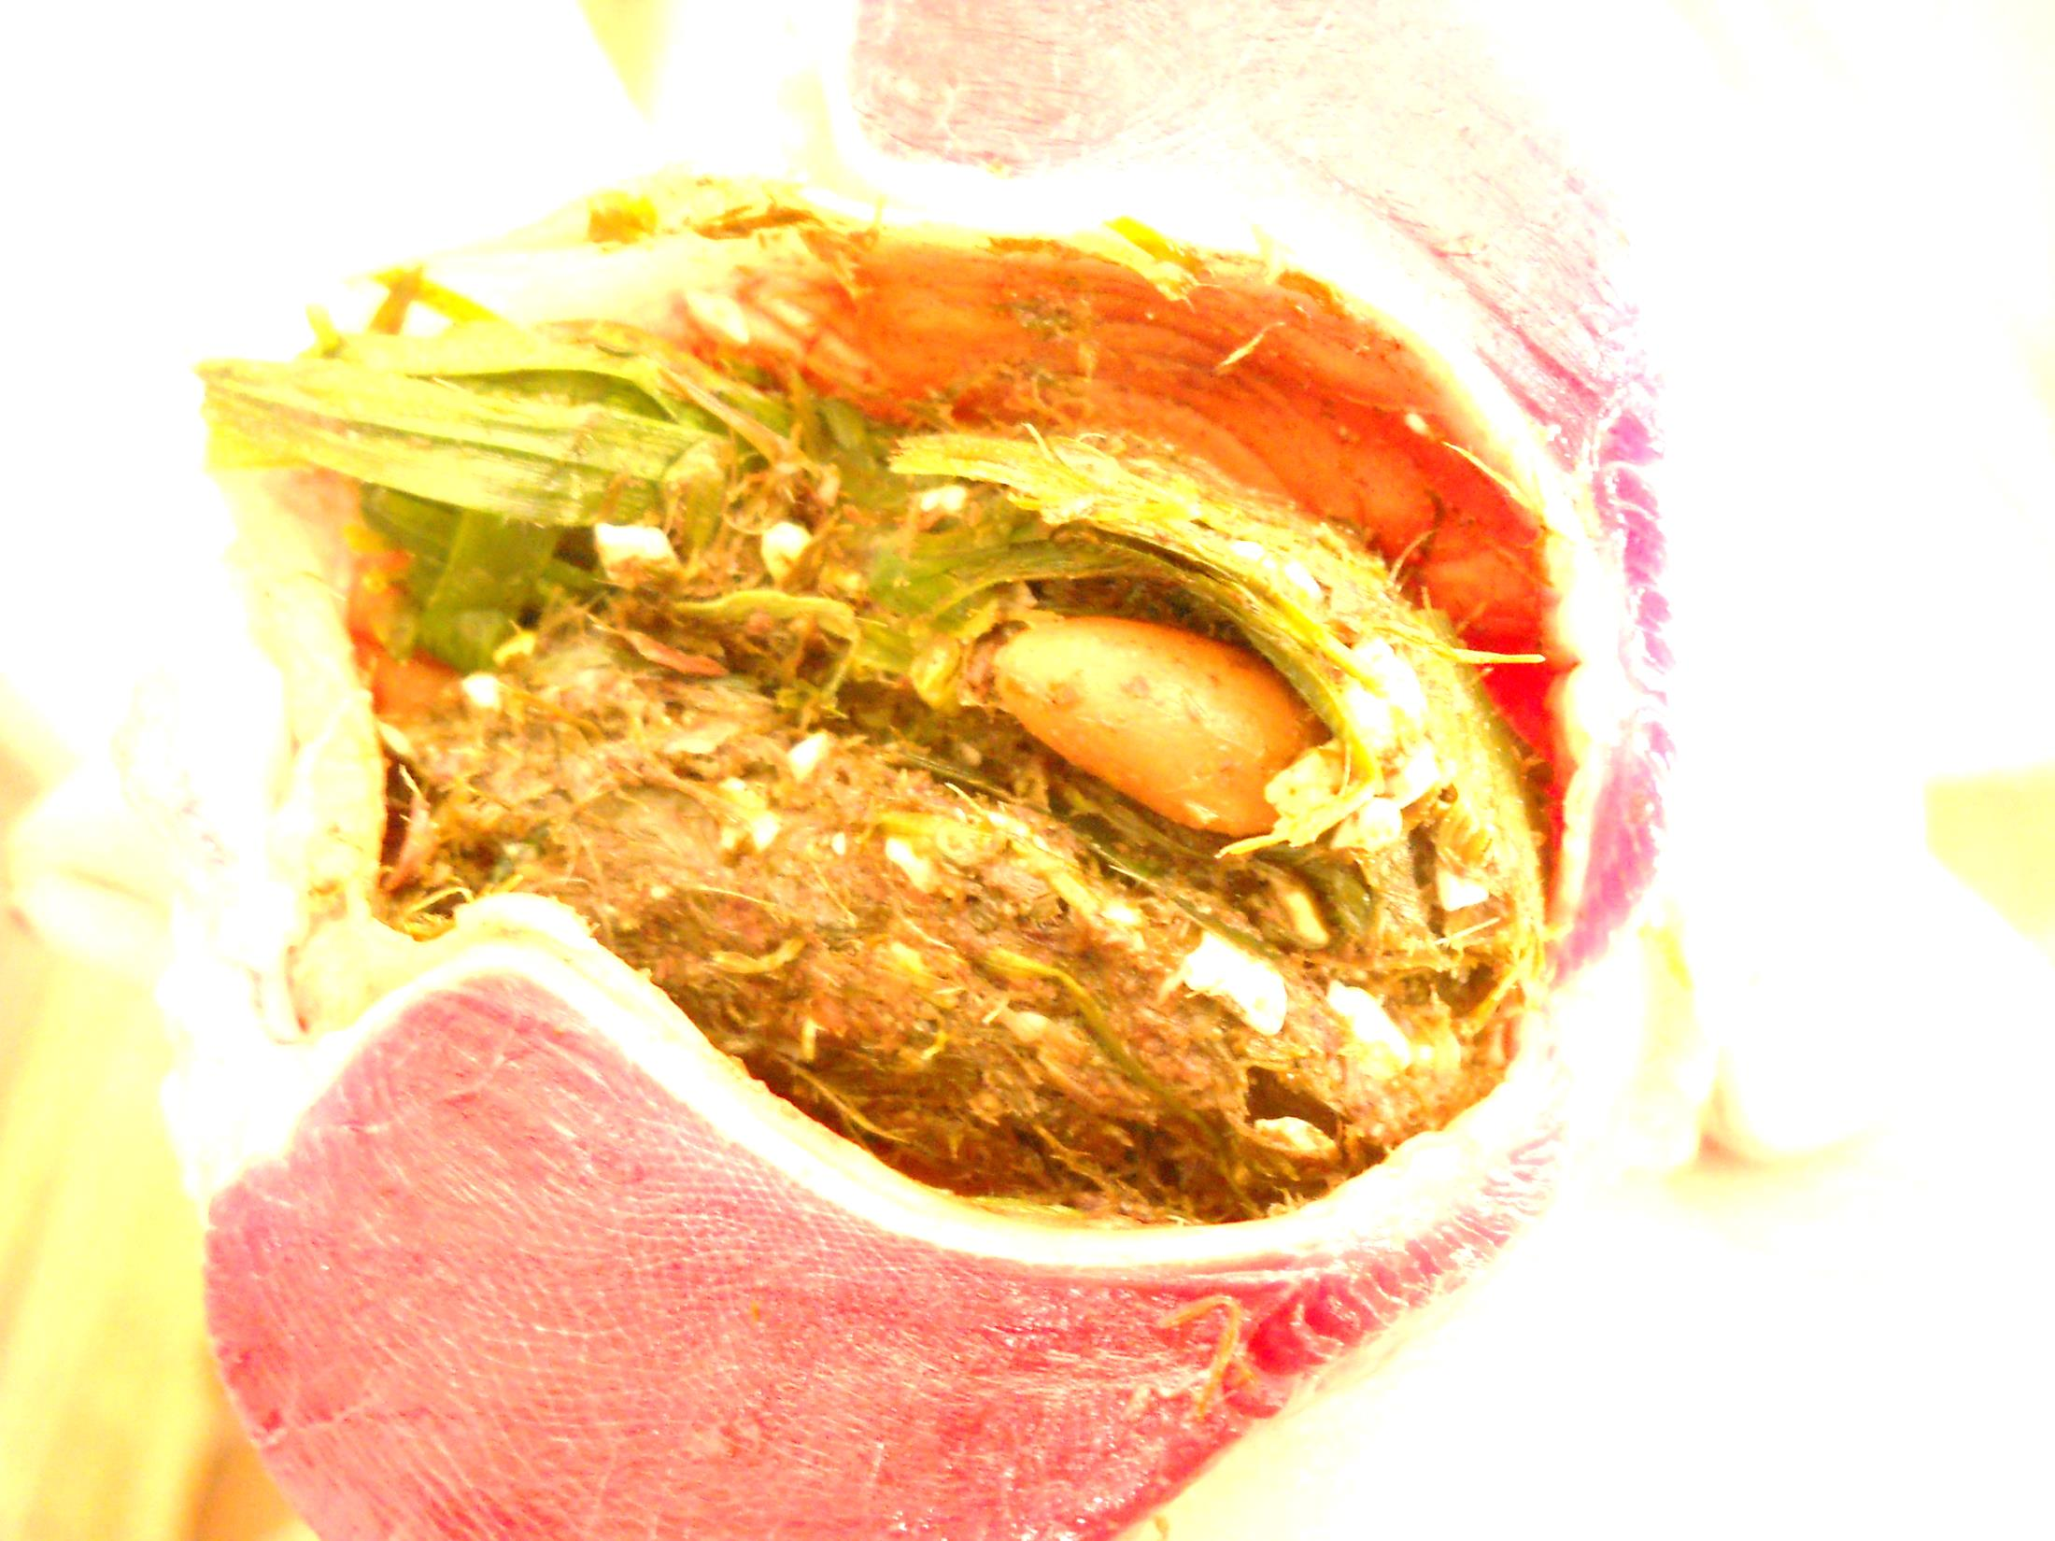
A regional project (Region of Umbria), funded within measure 1.2.4. of the RDP has been activated; the project is concerned with the role of trees in improving animal welfare and product quality, while providing feed, when raising local breeds of poultry and rabbit in agro-tourism farms.

Slide 9
Several more research activities could be classified and reported as Agroforestry, but they sinpoly do not know!
We need to let them know so they can join EURAF!

