Slide 1
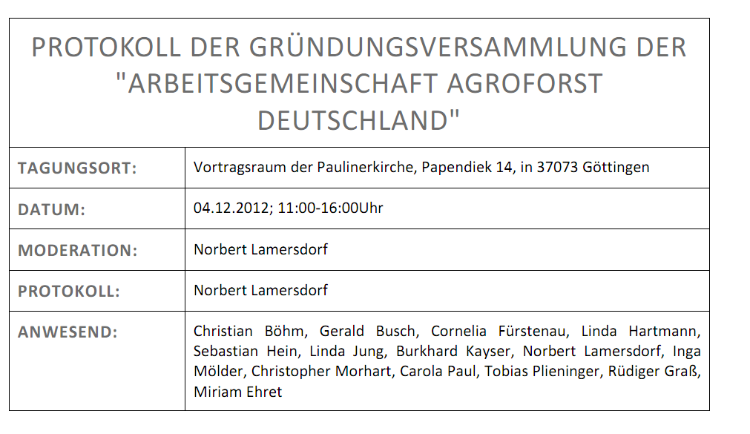
Working Group Agroforestry, Germany
35 "Followers"
14 Founders
18 National members (2014)
14 EURAF members (2014)

Slide 2
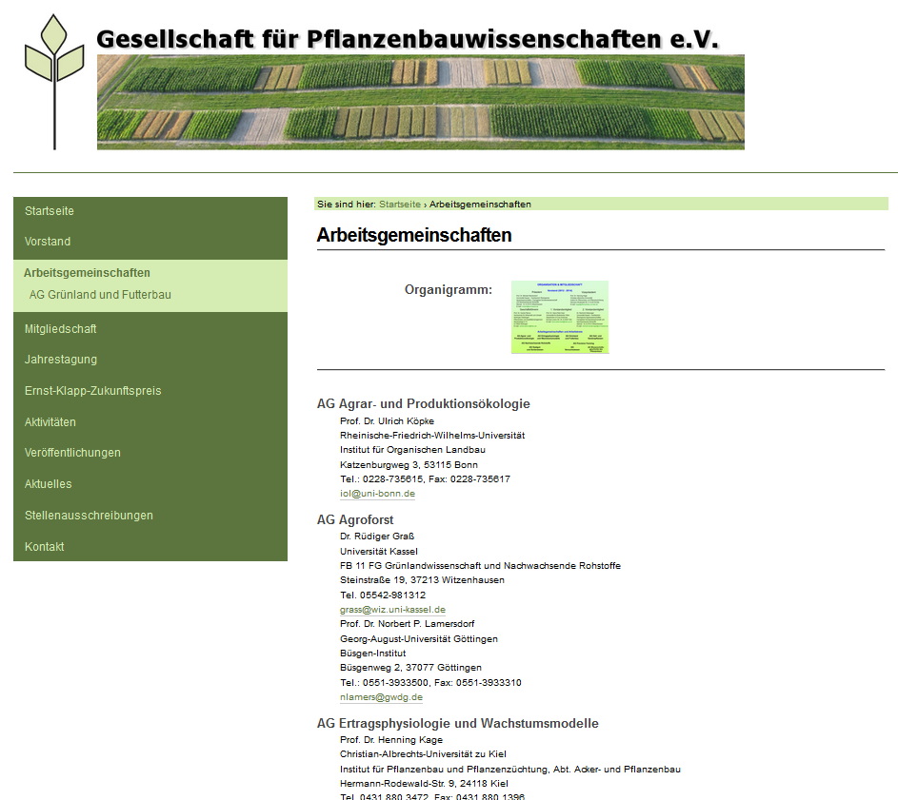
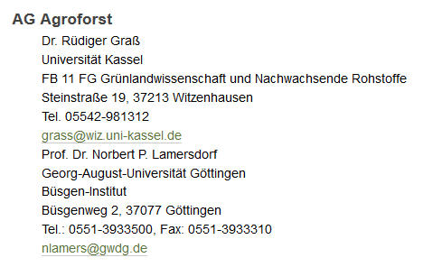

Slide 3
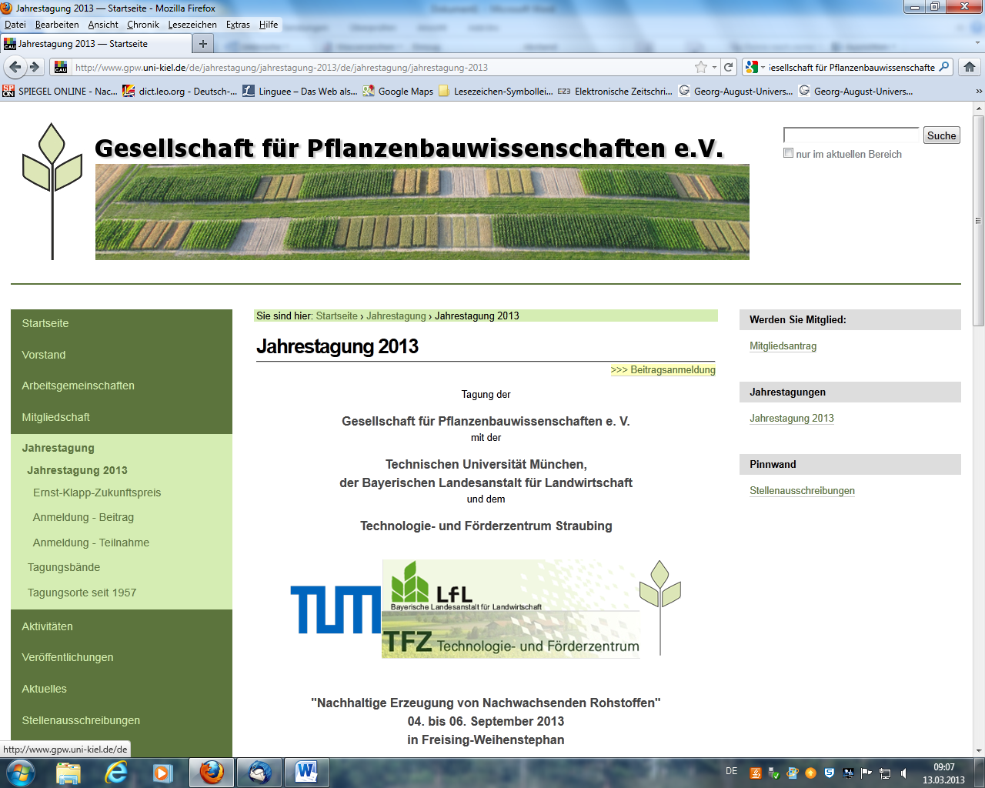
Including one extra session + one extra workshop on Agroforestry

Slide 4


Recent Activities
Submission of the proposal:
Sustainable intensification of agriculture through agroforestry
(SIGNAL)
Project call
"Soil as a Sustainable Resource for the Bioeconomy"
as part of the National Research Strategy
BioEconomy 2030

Slide 5
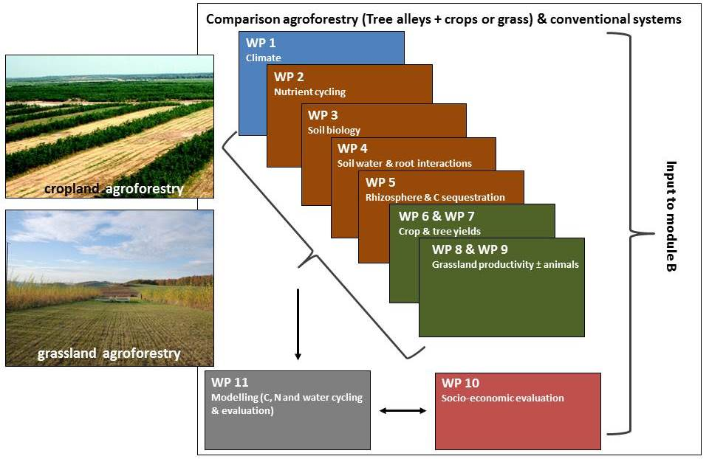
SIGNAL´s
Project Approach
The project coordinators + partners of WP 2, 6, 7, 8 and 9 have a strong link to the
"AG Agroforst" / EURAF

Slide 6
SIGNAL´s
Central Hypothesis
Innovative agroforestry systems are ecologically and economically more sustainable and socially more acceptable than conventional arable farming systems and, thus,
improve the societal sustainability of modern agriculture especially on marginal sites and sites with high potentials for leaching losses and soil erosion.

Slide 7
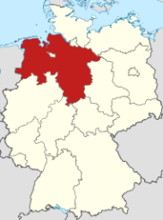
Current Political Situation
(Example for the State of Lowers Saxony)
REGULATION (EU) No 1305/2013, the European Agricultural Fund for Rural Development (EAFRD)
Exclusion of Article 21 – 26, i.e. everything which is related to "forest/trees" and thus also Agroforestry (Article 23)
Advise to Article 53 (European Innovation Partnership network, EIP), respectively Article 55 (EIP for Agricultural productivity and Sustainability)

