Slide 1
EURAF FRANCE
General Assembly, 4th June 2014, Cottbus
Sylvie Guillerme

Slide 2
2 national associations aiming at promoting trees
A diversity of actions !
AFAF
AFAHC
EURAF delegate : Sylvie Guillerme
EURAF delegate : Yves Gabory

Slide 3
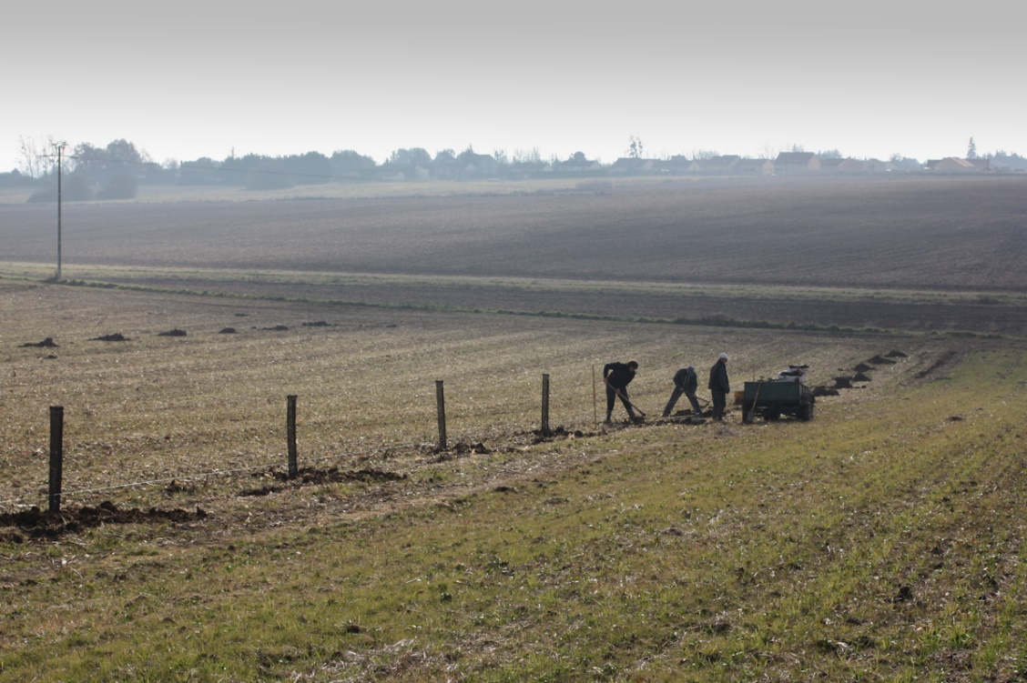
A dedicated work activity in the fields
Tree planting
Advicing
Close relations with local stakeholders in order to promote all types of agroforestry systems
Networking
…

Slide 4
A dedicated work activity in the fields
Plot visits
Exchange with the public
Transfer of knowledge with the farmers

Slide 5
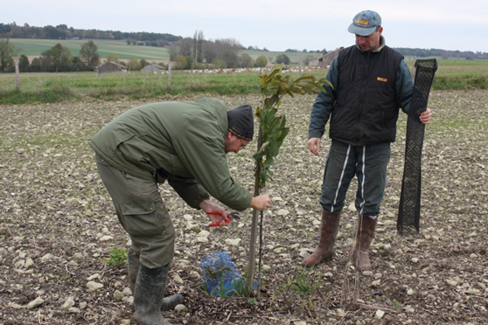
Many local, regional and national manifestations and projetcs
→ 2 millions trees planted

Slide 6
Many local, regional and national manifestations and projects
Visit of a French Minister on agroforestry plots
Press information

Slide 7
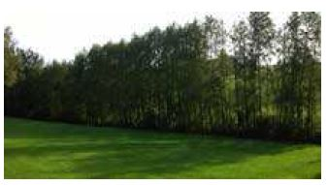
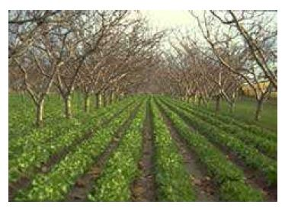
A global approach of the agroforestry issues
Production
Water
Environment
Bee & pollination
Natural regeneration
Education & training
…
→ Information given in newsletters

Slide 8
Involvment in Projects at the european level
A huge lobbying work regarding the CAP
Networking with the help of Fondation de France
A future pilote european project (A. Canet, M. Lamaison & Ch. Dupraz) « towards an integrated european agroforestry sector »
AGFORWARD
AGROFE

Slide 9
Advantages linked with euraf
Useful european logo: it gives credibility to sponsors, partners… → recognition of being part of a european network (international dimension)
Euraf provides helpful information on agroforestry in other countries
It gives a good feeling of exchange between countries (France is not alone and we can help each other in order to promote european agroforestry) → research, lobbying, founding…

Slide 10
Furure challenges… to be discussed !
PAC
Valorising multifunctionality
Trees in the city
Professional certification / referential
Education/training (advisers and farmers…)

Slide 11
« Alone we are going faster, together we are going further »,
African proverb
Thank you !

