Slide 1

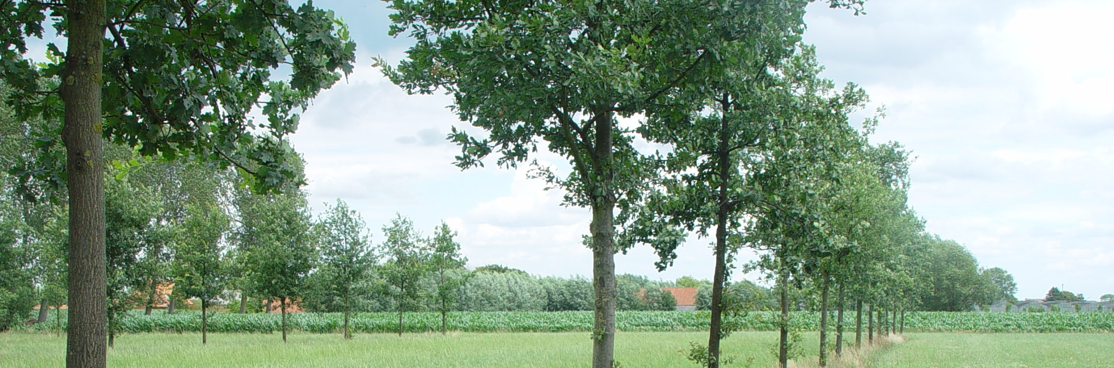
Agroforestry in Belgium
EURAF Conference Cottbus 4-6-2014
Institute for Agricultural and Fisheries Research
Plant Sciences Unit – Crop Husbandry & Environment
www.ilvo.vlaanderen.be
Agriculture and Fisheries Policy Area

Slide 2
State of Agroforestry related Associations
  Two member-organisations
  Wervel (25 EURAF members)
  AWAF – Association pour l’Agroforesterie en Wallonie et à Bruxelles (+-50 EURAF members)
  Flemish Consortium Agroforestry
  Informal collaboration between several stakeholder organizations (research institutes, sector service organizations, etc) active in agroforestry
  8 member organizations.
  Main results: set-up of experimental agroforestry site (2011) & approval of joint Flemish agroforestry research project (see EURAF newsletter)

Slide 3
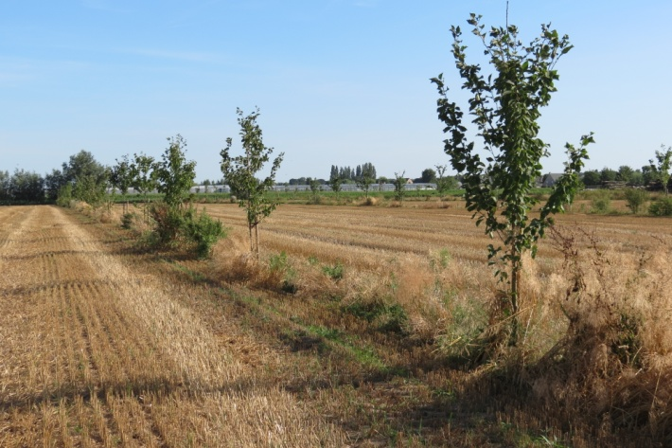
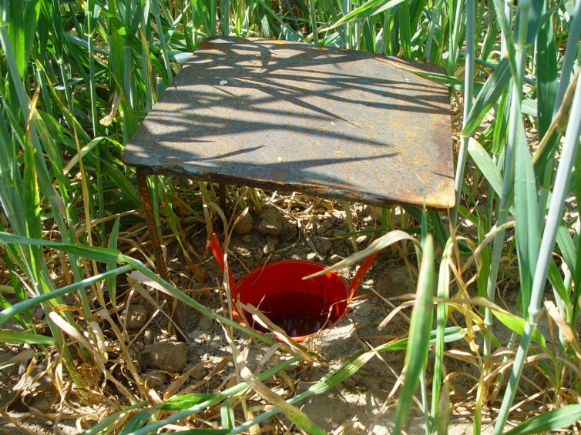
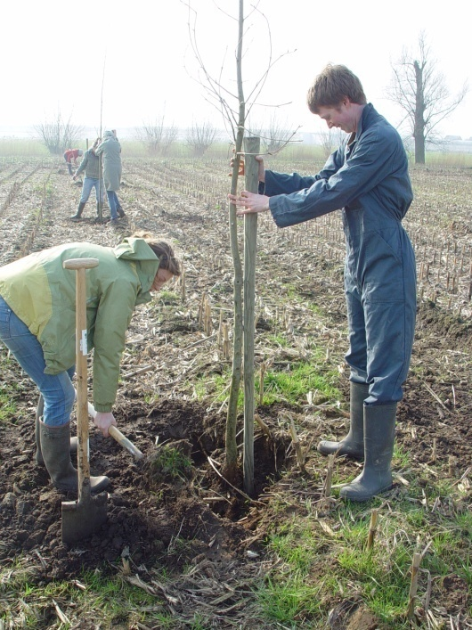
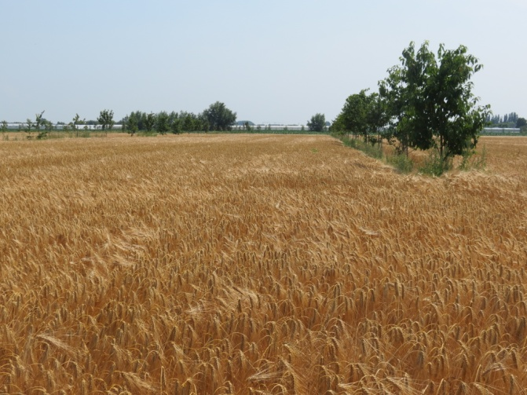
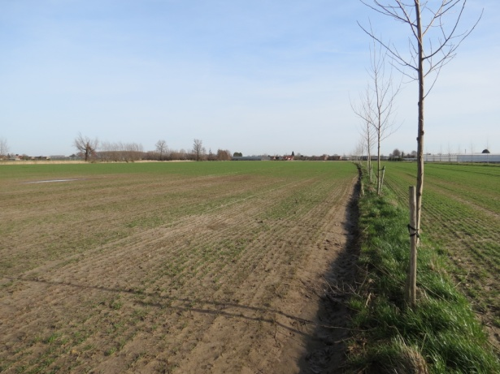
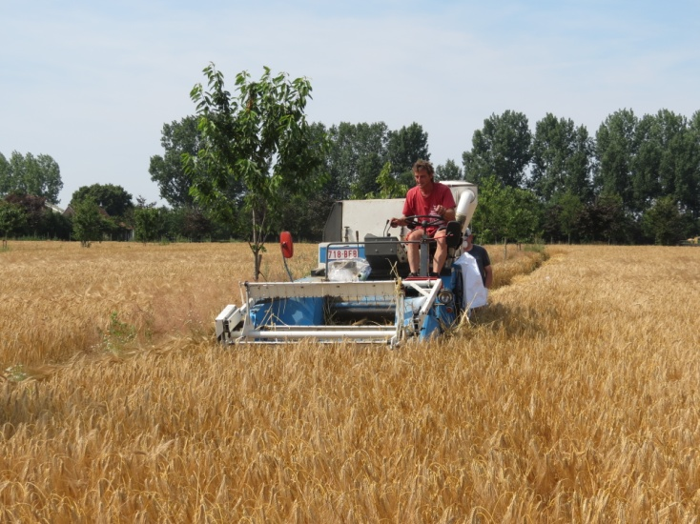
Experimental site Lochristi (Ghent area)

Slide 4
New agroforestry project (2014-2019)
  Objective: create a breakthrough of feasible, profitable and effective agroforestry systems in Flanders through:
  integrated collaboration throughout the entire chain of stakeholders
  co-development of research knowledge and practical experience
  provision of solutions and guidance for the target group.
  How? For a selection of agroforestry systems relevant to the Flemish agricultural context :
  Increasing knowledge of ecological interactions, ecosystem services, technical impact and especially economic opportunities
  Increased understanding of intention, attitude, norms, perception and social identity of those involved
  Providing decision support guidelines, practical suggestions and innovative solutions to farming enterprises
  Strengthen the international links (exchange of experience, knowledge, protocols for measurement ,etc)

Slide 5
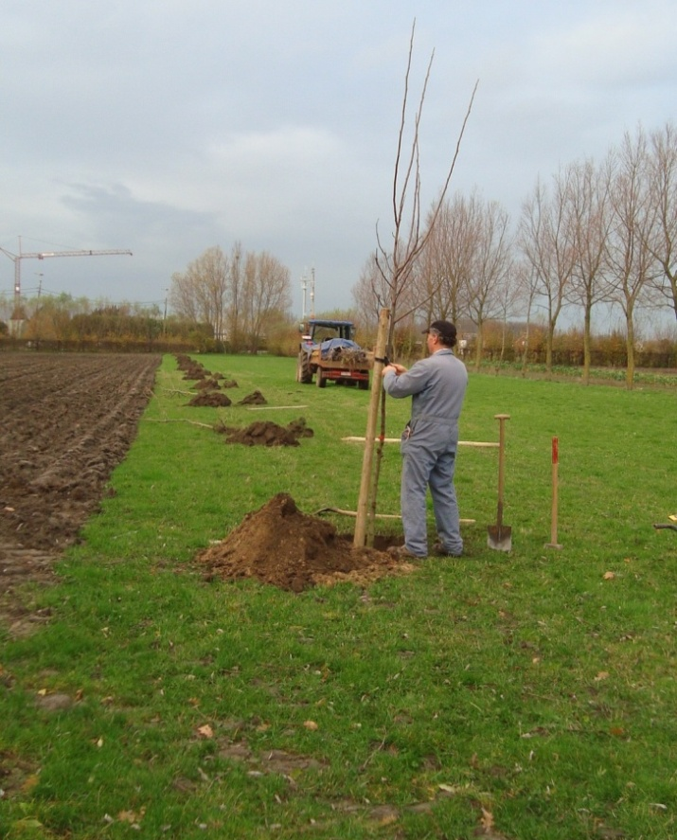
Agroforestry in practice
  Implementation in Flanders
  About 30 farmers showed interest over the last 2-3 years
  11 new parcels established in 2011-2012 with the agroforestry subsidy measure (about 10 ha)
  In 2013:7 new subsidy applications approved (about 20 ha)
  Implementation in Wallonia
  > 10 new agroforestry plantation projects beginning of 2014
  Some of these: stepwise plantations on a total area of > 20 ha
  Several new projects under preparation
  AWAF involved in all these projects

Slide 6
Agroforestry in practice
  Dynamics
  Several demo and info activities organised
  First steps towards more systematic exchange of info between both regions
  Slight increase in communication on agroforestry
  Bottlenecks hindering further implementation
  Often of legal or administrative nature
  Complexity of and potential conflicts between rules: Forestry decree, Nature decree, “Veldwetboek” (Country Code), Regional Planning Code, “Pachtwet” (land lease law)
  Uncertainty regarding ownership, tree-planting or treefelling permit (spatial planning regulation)
  But also: some technical and economic constraints (fear for loss in productivity)
  To be tackled over the next few years…

Slide 7
CAP and other policies affecting AF
  Flanders
  Agroforestry eligible for Pillar I subsidies (EFA)
  To be eligible, the parcel has to be established officially with the subsidy as defined in Pillar II, and the number of trees should not exceed 100/ha
  Pillar II: subsidy as started in 2011 continued, with some minor changes: 80% of total plantation costs refunded (i.o. 70%) + standard fee for own labor
  No subsidy for maintenance costs
  Wallonia
  Agroforestry eligible for Pillar I subsidies (EFA)
  No Pillar II subsidy?
  Subsidy of Departement of Nature and Forests (DNF) augmented

Slide 8
Expectations of EURAF
  To further stimulate concrete exchange and collaboration opportunities between partners
  Further elaboration of an informative website/platform where info and experiences on agroforestry everywhere in Europe is openly shared, and kept up to date
  Further promotion (and harmonisation) of policy at EU level
  Continue the conference / meeting initiatives as in Brussels and Cottbus
  Take the initiative to organise educational activities (agroforestry course, practical workshops, …)

